Slide 1
Moving Forward: Using Technology to Promote Thinking and Learning
Elizabeth Dobler
Melissa Reed
Emporia State University
Kansas Reading Association
October 21, 2011

Slide 2
Technology does not drive change….. it enables change. --author unknown
Notes:
We are here to talk about how teaching and learning is changing. And I would like to start with telling you how teaching and learning is changing for one person, me! Set off on my sabbatical to learn more about teaching writing. The title of my project was “Where have all of the writing teachers gone?” And I made plans to visit several classrooms of exemplary teachers and collect examples to bring back for my students. What I came away with has profoundly changed me as a teacher and as a learner.

Slide 3
It’s not about technology, it’s about learning. --Will Richardson
Notes:
But this isn’t a presentation about using technology. This presentation is about rethinking learning because of what we can do with technology, and specifically the Internet.

Slide 5
Everyone can be both a teacher and a learner.
Notes:
As I was trying to keep up with the students, I learned that you can learn how to use the Internet by using the Internet. Ex: how to add a picture to your blog
Lots of people like to help others learn on the Internet. There is a spirit of sharing that prevails.

Slide 6
The collective knowledge of the group is the most powerful problem solving tool.
Notes:
Collective knowledge – The social networking aspects of the Internet provide so many opportunities for us to connect – whether it’s through Twitter, Skype, Ning, or whatever site you choose. Ex: research team Skypes, shared documents, etc.

Slide 7
Technology Brings People Together
Create your own personal learning networks
Notes:
Helped me realize that the resources I need to answer any questions I have, solve any problem, seek any advice I need in teaching can be found on the Internet. Creating your personal learning network is about connecting with people and resources. Ex: Plurk, Ning, sharing favorite websites through Diigo
Personal Learning Networks: Using the Power of Connections to Transform Education

Slide 8
“During a period in which technology has fundamentally transformed America's offices, factories, and retail establishments, its impact within our nation's classrooms has generally been quite modest.”
– Report to the President on the
Use of Technology to Strengthen K-12 Education in the United States

Slide 9
If you think the future will require better schools, you’re wrong. The future of education calls for entirely different learning environments.
–Knowledge Words Foundation

Slide 10
“The illiterate of the 21st century will not be those who cannot read and write, but those who cannot learn, unlearn, and relearn.”
- Alvin Toffler

Slide 11
Common Core Standards
Prepare for and participate effectively in a range of conversations and collaborations with diverse partners, building on others’ ideas and expressing their own clearly and persuasively.
Integrate and evaluate information presented in diverse media and formats, including visually, quantitatively, and orally.
Make strategic use of digital media and visual displays of data to express information and enhance understanding of presentations.
Use technology, including the Internet, to produce and publish writing and to interact and collaborate with others.

Slide 13
Kansas

Slide 14
Project-based Learning
is an instructional approach built upon authentic learning activities that engage student interest and motivation.
is synonymous with learning in depth.
teaches students 21st century skills as well as content.
is generally done by groups of students working together toward a common goal.
allows students to reflect upon their own ideas and opinions, exercise voice and choice, and make decisions that affect project outcomes and the learning process in general.
Combining these considerations, Project Based Learning is defined as:
a systematic teaching method that engages students in learning essential knowledge and life-enhancing skills through an extended, student- influenced inquiry process structured around complex, authentic questions and carefully designed products and tasks.
Notes:
These activities are designed to answer a question or solve a problem and generally reflect the types of learning and work people do in the everyday world outside the classroom.
A well-designed project provokes students to encounter (and struggle with) the central concepts and principles of a discipline.
These skills include communication and presentation skills, organization and time management skills, research and inquiry skills, self-assessment and reflection skills, and group participation and leadership skills.
Performance is assessed on an individual basis, and takes into account the quality of the product produced, the depth of content understanding demonstrated, and the contributions made to the ongoing process of project realization.

Slide 15
Turning Point Learning Center

Slide 16
These ideas are not new . . .
The definition of what it means to be literate continuously changes as new technologies of literacy rapidly appear in an age of information, creating both new opportunities and new challenges for literacy educators.
How do we teach children to continuously become literate?
How do we help children learn to learn the new literacies that will continuously emerge?
Literacy is no longer an end point to be achieved and tested but rather a process of continuously learning how to become literate.
(Leu, 2000)

Slide 17
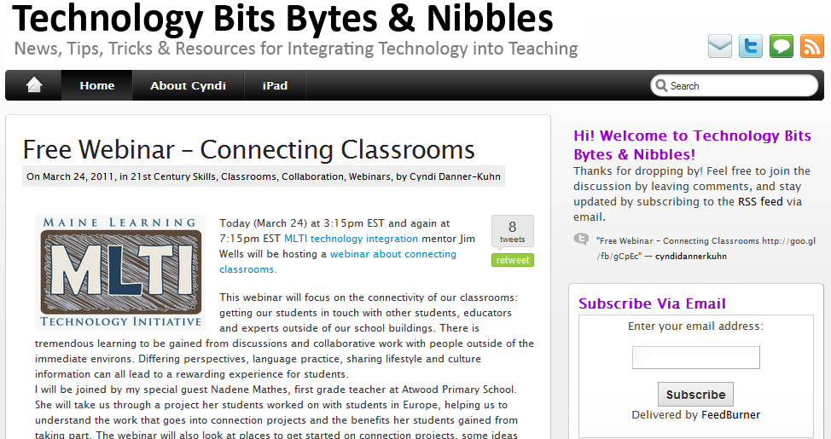
www.technologybitsbytesnibbles.info

Slide 18
http://podstock.ning.com

Slide 19
References
Hand image: healthandwelfare.idaho.gov
Teacher/learner: http://www.google.com/images?hl=en&biw=1024&bih=573&gbv=2&tbm=isch&btnG=Search&aq=f&aqi=&oq=&safe=active&q=teacher%20as%20a%20learner
Richardson, W. & Mancabelli, R. (in press). Personal learning networks. New York: Solution Tree.

